Slide 1
Testy zraku

Slide 2
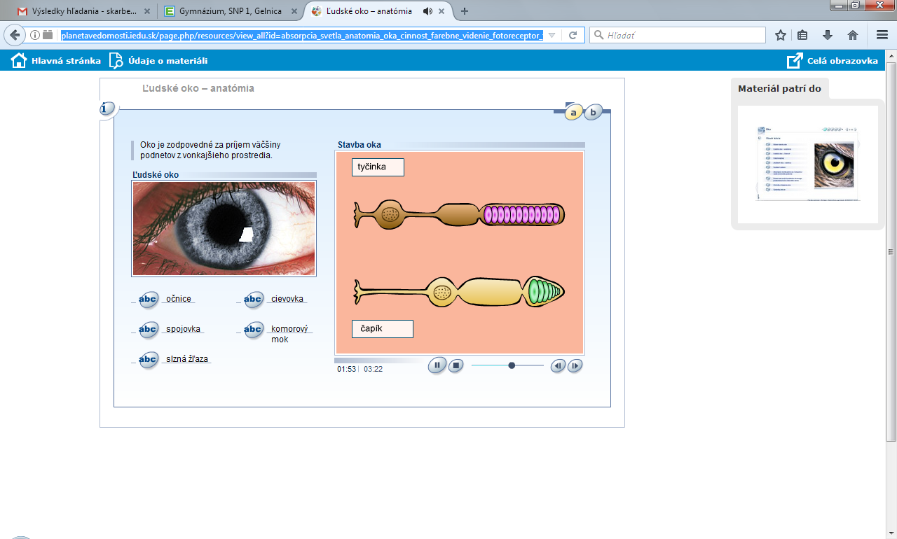
http://planetavedomosti.iedu.sk/page.php/resources/view_all?id=absorpcia_svetla_anatomia_oka_cinnost_farebne_videnie_fotoreceptor_fotoreceptory_hygiena_oko_opticky_nerv_poruchy_rodopsin_sietnica_stavba_page1&RelayState=http%253A%252F%252Fplanetavedomosti.iedu.sk%252Findex.php%252Fsearch%252Fresults%252FAkomod%2525C3%2525A1cia%252C0%252C0%252C0%252Cakomod%2525C3%2525A1cia%252C25%252C1%252Ctn%252C1.html&1

Slide 3
Akomodácia oka - zrenica
http://planetavedomosti.iedu.sk/page.php/resources/view_all?id=absorpcia_svetla_anatomia_oka_cinnost_farebne_videnie_fotoreceptor_fotoreceptory_hygiena_oko_opticky_nerv_poruchy_rodopsin_sietnica_stavba_t_page7&RelayState=http%253A%252F%252Fplanetavedomosti.iedu.sk%252Findex.php%252Fsearch%252Fresults%252FAkomod%2525C3%2525A1cia%252C0%252C0%252C0%252Cakomod%2525C3%2525A1cia%252C25%252C1%252Ctn%252C1.html&1

Slide 4
Stavba ucha
http://planetavedomosti.iedu.sk/page.php/resources/view_all?id=farebne_videnie_mechanizmus_pocutia_videnia_mnozstvo_svetla_oko_organ_pocutie_poruchy_regulacia_rovnovazny_stavba_oka_ucha_svetlo_ucho_zrakove

